Slide 1
Design for Verification Project Update
2020-02-08
Eldrick Millares (eldrick@stanford.edu)

Slide 2
Last Week’s Tasks
Refactor SQED + SSS Demo on RideCore
Demonstrate array of HW Trojans on RideCore
Re-examine current SSS constraints / assertions / assumptions on vscale & ridecore
Draft strategy to deploy technique on BOOM

Slide 3
Status Updates - RideCore Refactor + Demo
https://github.com/eldrickm/sqed_sss.git
In process of selecting and uploading RideCore example.
Will be completed end of day Tuesday
Good entry point for Jack
Add / demonstrate Ticking Timebomb Trojans on this design
Extremal Bugs
~2% of “extremal bugs” not found in 24 hours
Interested in this 2% - what characteristic made them hard to find?
Possible new class of “elusive trojans” - can we identify and reproduce?
Notes:
Collected relevant papers and drafts
Added presentations hidden away
Improved documentation and infrastructure

Slide 4
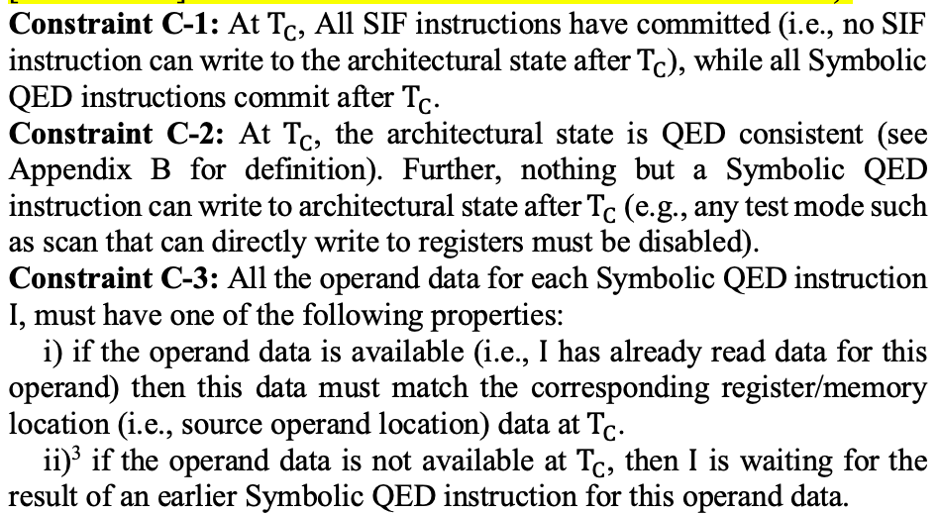
Status Update - SSS Constraints As Assertions

Slide 5
Status Update - SSS Constraints As Assertions
Working on a visual aid for current formulation of SSS constraints
Aim to show instructions in flight / time of commit / operand forwarding
Could be worth typesetting current draft for better readability
Cataloging simplifications to processors
Anticipate reviewing current constraints with Florian later in the week
Can use formulation from FMCAD paper as lens to review SSS constraints

Slide 6
Upcoming Tasks
Deploy TTT / extremal trojans on RideCore
Catalog RideCore / Vscale Simplifications
Start ablation testing with some of these modifications
Catalog any interesting counterexamples with some simplifications disabled
Create visual aid for current SSS constraints
Typeset current draft

